Slide 1


PHP & MySQL
CEC presentation
INFO233 – Programming in Visual Basic
Spring 2012
Presented by: Samantha Naini

Slide 2
What is MySQL?
“SQL” – Structured Query Language
Online relational database management system
Information warehouse for websites
Open-source
GNU General Public Licensing
Completely free of charge
Controlled by PHP commands

Slide 3
Brief History of MySQL
Invented by Michael Widenius, David Axmark, and Allan Larsson
Made open-source in 2000, but there were financial problems
Hired famous Swedish CEO named Marten Mickos to maximize revenues
Took part in many venture capital investments
Improved marketing strategies led to success
(2006) thirty-three percent market share on Wall Street
Sold to Sun Microsystems for $1 Billion in 2008

Slide 4




















Slide 5
What is PHP?
PHP – Hypertext Preprocessor
Server-side scripting language
Invented by Rasmus Ledorf in 1995
Works with HTML, but does not appear in source code
Also open-source and free of charge
Primary scripting language on over 20 million websites

Slide 6
How PHP & MySQL are used together
MySQL serves as storage alone
PHP commands alter data in MySQL
They can also perform complex calculations
MySQL can also be accessed on PHPMyAdmin
PHPMyAdmin.com has an easy-to-use interface
Much like Microsoft Access except it is online
PHP commands executed through web server
Password protection of data

Slide 7
How PHP code looks
<html>
<body>
<?php
$d=date("D");
if ($d=="Fri")
echo "Have a nice weekend!";
elseif ($d=="Sun")
echo "Have a nice Sunday!";
else
echo "Have a nice day!";
?>
</body>
</html>
<?php
$con = mysql_connect("localhost","peter","abc123");
if (!$con)
{
die('Could not connect: ' . mysql_error());
}
// Create database
if (mysql_query("CREATE DATABASE my_db",$con))
{
echo "Database created";
}
else
{
echo "Error creating database: " . mysql_error();
}
// Create table
mysql_select_db("my_db", $con);
$sql = "CREATE TABLE Persons
(
FirstName varchar(15),
LastName varchar(15),
Age int
)";
// Execute query
mysql_query($sql,$con);
mysql_close($con);
?>
<html>
<body>
<?php
function add($x,$y)
{
$total=$x+$y;
return $total;
}
echo "1 + 16 = " . add(1,16);
?>
</body>
</html>
<html>
<body>
<?php
echo "Hello World";
?>
</body>
</html>

Slide 8
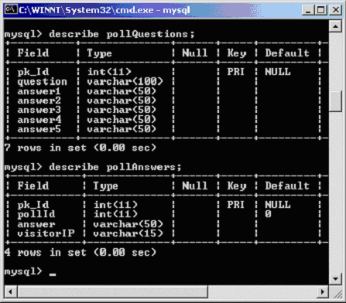
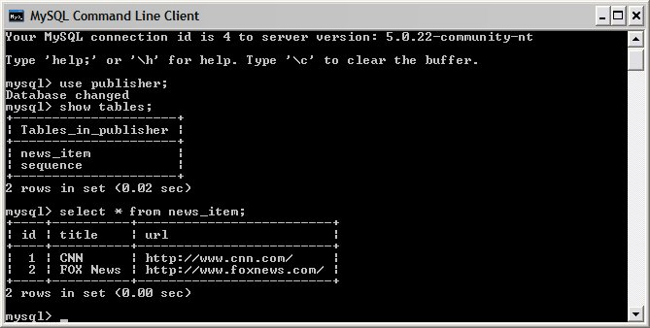
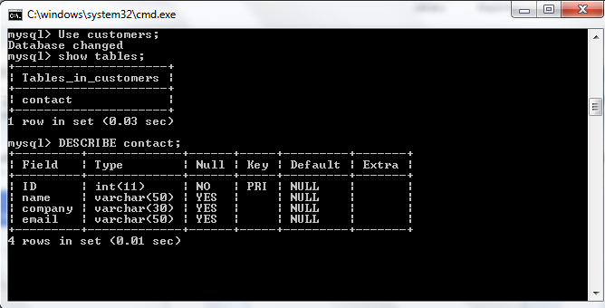
How MySQL looks

Slide 9
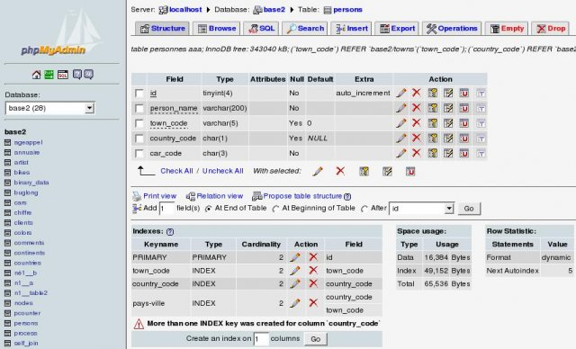
MySQL on PHPMyAdmin.com

Slide 10
Why is all of this used?
To make websites more dynamic
User interaction with the webpage
Extremely cost effective for startups and major companies
Fast speeds, reliable programs
MySQL capacity – eight MILLION terabytes

Slide 11
Conclusion
Use of PHP and MySQL has revolutionized the web
Key open-source tools for aspiring entrepreneurs
Required for most websites to function today

